Slide 1
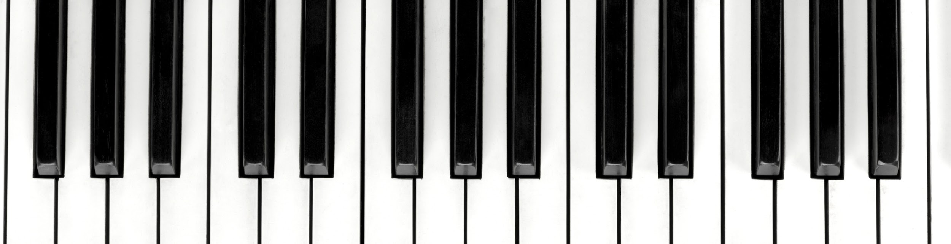
LaPiano
A full length piano, accessible anywhere, on your computer keyboard
Coders: Jordan Cohen and Jean Ng
Sources: Zulko - https://github.com/Zulko/pianoputer

Slide 2

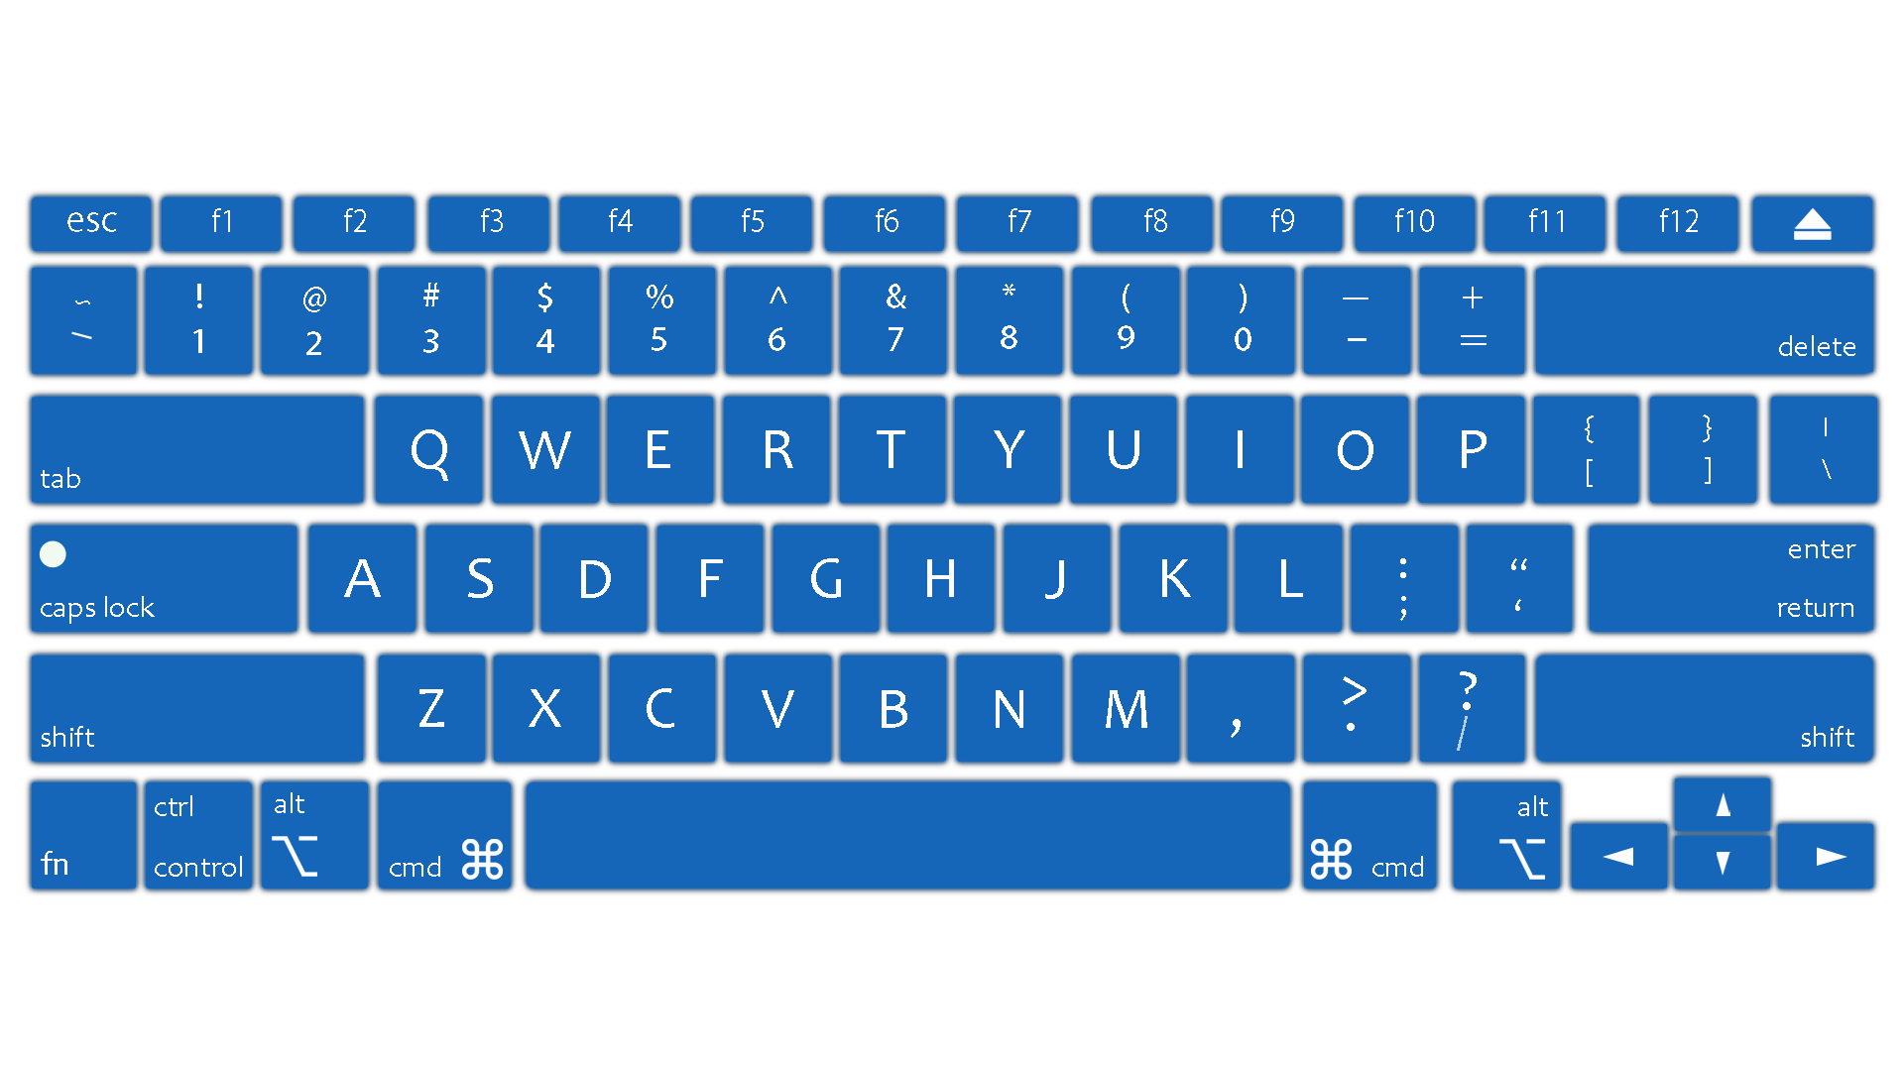
Time to create your music
Each laptop’s keyboard key will be assigned to a piano keyboard key.

